Slide 1
C++ Expression
C++ expression consists of operators, constants, and variables which are arranged according to the rules of the language. It can also contain function calls which return values. An expression can consist of one or more operands, zero or more operators to compute a value. Every expression produces some value which is assigned to the variable with the help of an assignment operator.
Examples of C++ expression:
(a+b) - c
(x/y) -z
4a2 - 5b +c
(a+b) * (x+y)

Slide 2
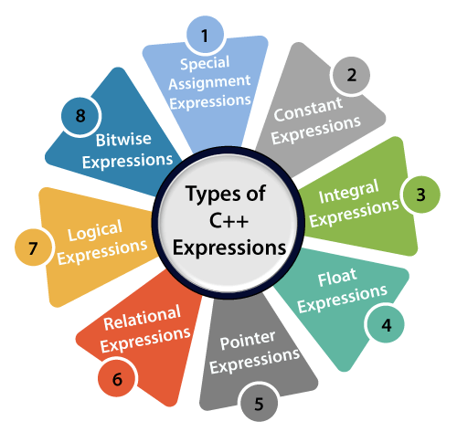

Slide 3
Constant expressions
A constant expression is an expression that consists of only constant values. It is an expression whose value is determined at the compile-time but evaluated at the run-time. It can be composed of integer, character, floating-point, and enumeration constants.
Constants are used in the following situations:
It is used in the subscript declarator to describe the array bound.
It is used after the case keyword in the switch statement.
It is used as a numeric value in an enum
It specifies a bit-field width.
It is used in the pre-processor #if

Slide 4
Let's see a simple program containing constant expression:
#include <iostream>
using namespace std;
int main()
{
int x; // variable declaration.
x=(3/2) + 2; // constant expression
cout<<"Value of x is : "<<x; // displaying the value of x.
return 0;
}

Slide 5
Integral Expressions
An integer expression is an expression that produces the integer value as output after performing all the explicit and implicit conversions.
Following are the examples of integral expression:
(x * y) -5
x + int(9.0)
where x and y are the integers.

Slide 6
Float Expressions
A float expression is an expression that produces floating-point value as output after performing all the explicit and implicit conversions.
The following are the examples of float expressions:
x+y
(x/10) + y
34.5
x+float(10)
Pointer Expressions
A pointer expression is an expression that produces address value as an output.
The following are the examples of pointer expression:
&x
ptr
ptr++
ptr-

Slide 7
Relational Expressions
A relational expression is an expression that produces a value of type bool, which can be either true or false. It is also known as a boolean expression. When arithmetic expressions are used on both sides of the relational operator, arithmetic expressions are evaluated first, and then their results are compared.
The following are the examples of the relational expression:
a>b
a-b >= x-y
a+b>80

Slide 8
Logical Expressions
A logical expression is an expression that combines two or more relational expressions and produces a bool type value. The logical operators are '&&' and '||' that combines two or more relational expressions.
The following are some examples of logical expressions:
a>b && x>y
a>10 || b==5

Slide 9
Bitwise Expressions
A bitwise expression is an expression which is used to manipulate the data at a bit level. They are basically used to shift the bits.
Special Assignment Expressions
Special assignment expressions are the expressions which can be further classified depending upon the value assigned to the variable.

